Slide 1
Empirical Investigation
Chapter 4

Slide 2
Empirical Studies
Selecting the best or optimal tool or technique requires some empirical support
Empirical research is based on observed and measured phenomena and derives knowledge from actual experience rather than from theory or belief.
Empirical studies are conducted to test the theory or belief
Empirical studies do not prove that a theory is true; rather, they provide further evidence to support or refute the theory
An empirical study examines some specific sample or observation of all the possible values of the variable involved in a cause-effect relationship.

Slide 3
Empirical Studies

Slide 4
Empirical Studies
Key characteristics involved in designing empirical studies include:
The level of control of study variables (e.g., population, behavior, or phenomena) that determines the appropriate type of study
Study goals and hypotheses
Maintaining control of variables
Threats to validity
The use of human subjects

Slide 5
1. Control of Variables and Study Type
Controlled experiments involve the testing of well-defined hypotheses concerning the postulated effects of independent variables on dependent variables
Sometimes the input variables can not be controlled, e.g., in the research areas of astrophysics and geology.
Ethical and legal issues are also factors that prevent conducting experiments.

Slide 6
Investigation Type

Slide 7
Experiments: When Research is Small
● Experiments require a great deal of control; they tend to involve small numbers of people or events
● Controlled experiments tend to be conducted in academia or research labs
● Rarely performed in a software industrial environment, as controlling for confounding factors are hard

Slide 8
Case Studies: Research is Typical
Empirical studies that involve observations where potential confounding variables cannot be controlled and/or subjects cannot be assigned to treatment or control groups are called observational studies, natural experiments, and/or quasi-experiments
A case study documents activity by identifying key factors (inputs, constraints, and resources) that may affect the outcomes of a research
Empirical studies in software engineering are case studies that involve the use of a tool or technique on projects without random assignment of subjects to projects and control of all other variables
Experiments are controlled, case studies are observational data collection and study
If the activity has yet to occur, you may choose between a case study and a controlled experiment. If the investigation has already occurred, you must perform a survey or case study

Slide 9
Experiments vs Case Studies (Table is read across and up)

Slide 10
Survey: Research is Large
The Survey is an empirical method that enables researchers to collect data from a large population.
The main aim of the survey is to generalize the findings
Surveys try to pool what is happening broadly over large groups of projects
A survey is a retrospective study of a situation to try to document relationships and outcomes
A survey is done after an event has occurred
Steps of a survey include: Identifying the objective, target audience, instruments/questionnaire design, instruments/questionnaire evaluation, analysis, conclusion, and documentation

Slide 11
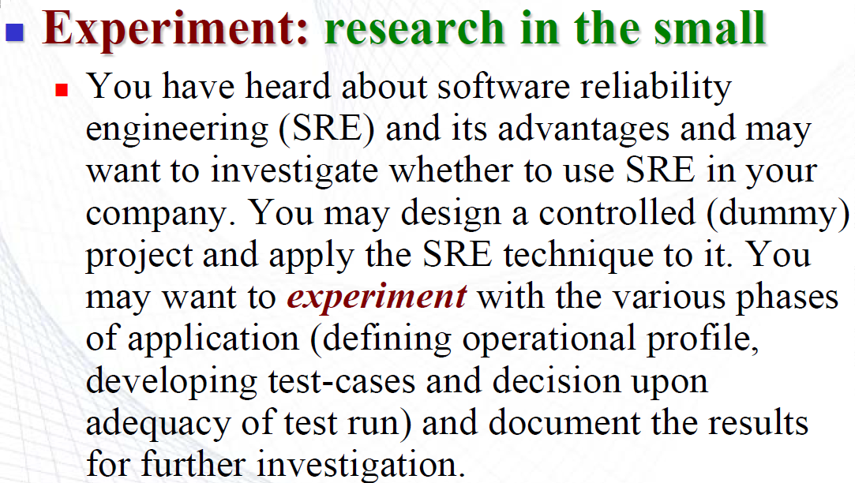
Example:

Slide 12
Example
Case Study: research in the typical
You may want to use or may have used software reliability engineering (SRE) for the first time in a project. You can perform case studies to capture different aspects.

Slide 13
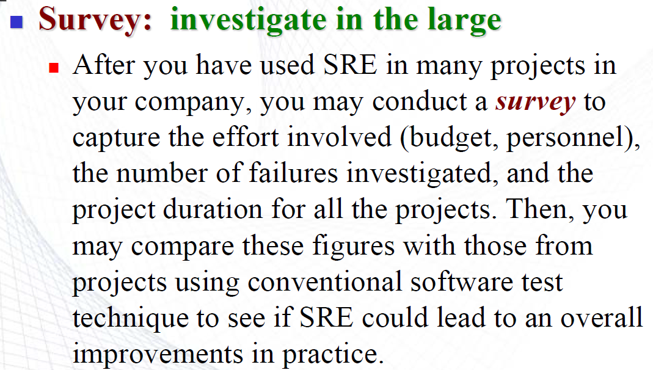
Example

Slide 14
2. Study goal and hypothesis
The goal of the research can be expressed as a hypothesis that you want to test.
Hypothesis: A tentative idea that you think explains the behavior you want to explore
A hypothesis should be empirically testable
The hypotheses must be conceptually clear and specific
The hypotheses should be related to a body of theory or some theoretical orientation
Hypotheses should have quantitative terms and in terms of independent and dependent variables that are as direct and unambiguous as possible

Slide 15
Hypothesis example
● Using the Scrum method produces better quality software than using the XP method
- is a hypothesis. However, it is not testable because the notion of quality is not given in a measurable way
You can define “quality” in terms of the defects found and restate the
hypothesis as -
If using the Scrum method produces better quality software than using the XP method, then code produced using Scrum will have fewer defects per thousand lines of code than code produced using the XP method.

Slide 16
3. Maintaining Control over Variables
The key discriminator between experiments and case studies is the degree of control over variables. A case study is preferable when you are examining events where relevant behaviors or variables can not be manipulated.
● State variable = independent variable that characterizes the project or goals
Example: Suppose your hypothesis involves the effect of programming language on the quality of the resulting code. “Language” is a state variable, and an ideal experiment would involve projects where many different languages would be used
● The treatment is any independent variable manipulated by the experimenter
Example: If you want to test whether a new testing strategy is better than other used testing strategies, the new one is a treatment
● After the case studies, you take a sample from the state variables for your project. So, if you have less control over the state variables of your project and if you are not sure about any treatments, then you must have to choose a case study instead of an experiment

Slide 17
4. Threats to Validity
No study is perfect. Potential problems with empirical studies are classified as categories of Threats to Validity
1. Conclusion Validity: A study has conclusion validity if the results are statistically significant using appropriate statistical tests over the independent and dependent variables.
Threats to conclusion validity include using the wrong statistical tests, having too small a sample, etc.
2. Construct Validity: Construct validity is used to determine how well a test measures what it is supposed to measure
For example, using the measure faults per KLOC as a measure of code quality has some threats to validity since its value depends in part on when the measure is taken, for example: during testing(faults found during testing) or after release (faults found by customers)

Slide 18
4. Threats to Validity
3. Internal Validity: Internal validity refers to the cause-effect relationship between independent and dependent variables. A study has internal validity if the treatment actually caused the effect.
Specific threats include the effects of other, possibly unidentified variables.
4. External Validity: External validity refers to how well you can generalize from the findings of a study to other situations, people, settings, and measures. In other words, can you apply the findings of your study to a broader context?.
seven threats to external validity: selection bias, history, experimenter effect, Hawthorne effect, testing effect, aptitude-treatment, and situation effect
Hawthorne effect: The tendency for participants to change their behaviors simply because they know they are being studied.

Slide 19
5. Human Subject
Consent!!!!!!
Should not be any harm or damage or injury to the subjects while studying.
Software engineering studies rarely involve risks of physical harm to human subjects. The major risks are due to privacy issues.

